Slide 1
Alternative Provision in Westmorland and Furness
Partnership working with providers and schools

Slide 2
Partnership working with providers and schools
22 providers based in Westmorland and Furness of which three are registered independent schools
Approx. 15 providers commissioned from out of county
Range of provision offered across the county
Very few providers delivering GCSEs
Strong sense of partnership working across the area
With teams and services to carry out joint quality assurance visits
Working with providers to develop key pieces of work i.e. Furness Transition Group, summer transition activities
Signposting providers to shared CPD opportunities i.e. LADO/SEND/Early Help
Building positive links with providers
Supporting providers to develop new provision
Support and ‘permission’ from senior leaders to prioritise working with Alternative Provision providers

Slide 3
The quality assurance framework
The QA framework is focused on the following 6 sections –
Leadership and management
Safeguarding
Information sharing and data protection
Teaching, learning, outcomes, and accreditation
Pupil and pastoral support
Transition
The document also includes – Guidance on how to use the document, description of the ‘validation’ process, a shorter focussed form for the Virtual School to assess provision they may commission, the Attendance return form and a section on reference documents, websites and further reading.
The QA Framework is intended to provide additional information to support schools and services commissioning provision, as well as providing a self-evaluation/development tool for providers

Slide 4
The quality assurance (cont.)
Underpinning the QA framework…
The AECPQAF is accredited to organisations which can successfully demonstrate their practice on these priorities. In addition, the framework supports the ‘elements of successful alternative provision’ as defined by Ofsted, which include:
At its best, AP is timely, well-planned, and not a last resort or a bolt on;
Students remain a full part of the school at all times and at no time are ‘out of sight, out of mind’;
The provision compliments, not replicating or replacing, the school’s own curriculum;
The school or unit provides pastoral support to ensure that students are not isolated when at placements and can seek advice back at school when needed;
If the provision is accredited, the school or college is clear about the purpose of accreditation. The accreditation is not tokenistic; it is valued by the school, recognised by future employers or colleges, and compliments rather than replicates the accreditation being gained in school - Ofsted, Alternative Provision, June 2011

Slide 5
The quality assurance process
Providers are invited to express their interest in achieving the QA framework
Conversation with interested providers describing how to use the framework and the validation process
Provider uses the framework to evidence their current practice – and to identify where there is strong practice and areas for development
The validation team prepare for the visit by checking the provider website, having access to referral documents, policies & procedures etc
The validation process is carried out – a day spent with the provider, looking at documents (register/policies & procedures/annual report/referral documents etc), systems (recording attendance/single central record etc) student files, health and safety, safeguarding procedures etc. An important part of the process is meeting the students and the opportunity to ask them about their experience and the education they are receiving
A report is written up which is discussed with the provider; an action plan is agreed to address any gaps in provision – action plans are reviewed
The report and provider documents are uploaded to the School Portal to ensure that schools can access the information to support their commissioning processes
Post validation – where an issue arises a meeting is arranged with the provider as a priority

Slide 6
Quality assurance (cont.) Leadership and management – sample page
Area | Success Criteria | Evidence seen y/n | Notes
Management structure and function | There is a clearly understood staffing structure which identifies roles, responsibilities, and lines of accountability Leaders and managers are actively involved in the development of all aspects of provision using evidence and data gathered through pupil progress, outcomes, and achievement | Yes Yes | Staffing structure chart Development plan
Governance | The organisation has an appropriate Governing Body/Management Committee/ Board of Trustees as appropriate The Governing Body/Management Committee/Board of Trustees meets on a regular basis to oversee the functioning and duties of the service Records of meetings are maintained | Yes Yes Yes | Annual report Leadership structure GB roles and responsibilities Agendas and minutes of meetings
Reference materials | Creating opportunity for all. Our vision for alternative provision. March 2018, Department for Education. Reference: DFE-00072-2018 Special Educational Needs and Disabilities (SEND) and Alternative Provision (AP) Improvement Plan, Right Support, Right Place, Right Time March 2023 ISBN 978-1-5286-3924-8

Slide 7
Gathering information from schools and services

Slide 8
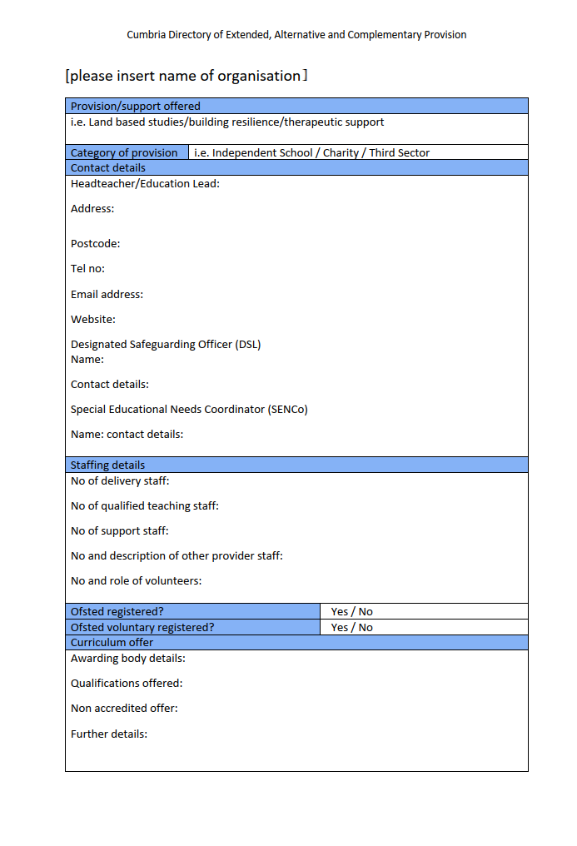
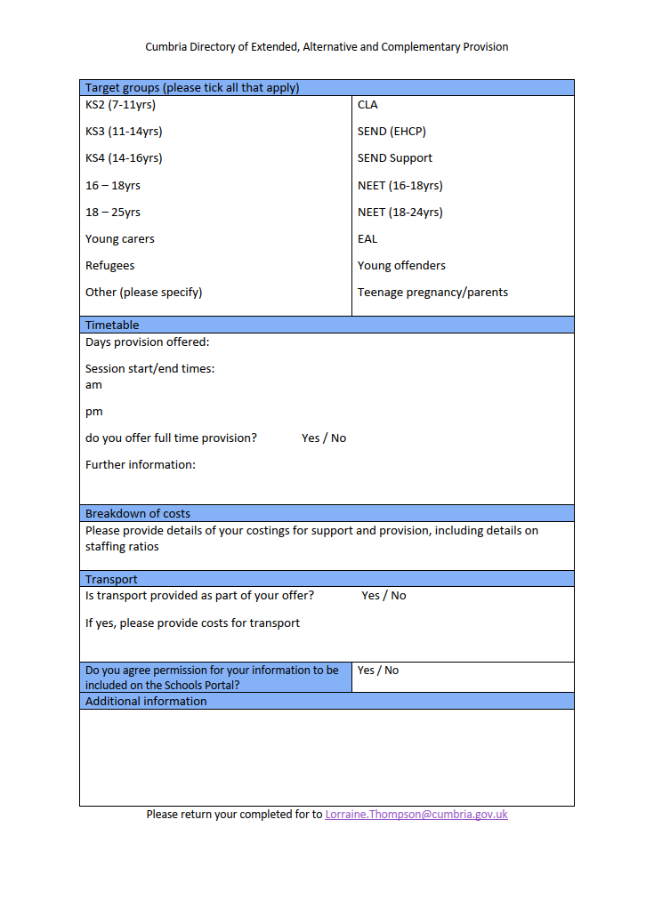
Gathering information from providers

Slide 9
Reporting attendance

Slide 10
Reporting attendance (cont.)
Please find attached the monthly attendance census return form to record your student attendance for June 2023.
This information is important because it is one strand of our Safeguarding duties and is a priority for Keeping Children Safe in Education - https://www.gov.uk/government/publications/keeping-children-safe-in-education--2
The Dept for Education states that:
‘Local authorities have a duty (8) to put in place arrangements for identifying (as far as it is possible) those children of compulsory school age in their area who are not school registered or receiving suitable education otherwise than at a school. Local authorities should trace those children and ensure that they receive full-time education.’ (School Attendance – Guidance for maintained schools, academies, independent schools and local authorities May 2022’ pg 8) https://assets.publishing.service.gov.uk/government/uploads/system/uploads/attachment_data/file/1073591/School_attendance_guidance_May-2022.pdf
The monthly attendance census provides us with information required to fulfil our duties and to assist us with identifying children and young people who are not on a school roll and/or not known to services.
Please complete the attendance census for all students attending your provision, including those on a school roll. The form uses codes to record attendance and absence; the codes are the same as those used by mainstream schools to ensure consistency in data.

Slide 11
The current situation
Growing number of personal tutors
Growing number of providers offering outdoor activities
Ensuring the quality of provision for children and young people who are Education Other Than at School (EOTAS) and Electively Home Educated (EHE)
Ensuring that parents and carers have good information to support their decision making for commissioning provision as part of an EOTAS package
Reluctance of many providers to register as an independent provision
Provider struggles to recruit appropriately qualified members of teaching staff
Pressures on school budgets and the impact this has on commissioning provision

Slide 12
Next steps
Continue to identify actions and priorities to improve outcomes for children and young people who attend Alternative provision
Scrutinise the data for children and young people who attend/have attended Alternative Provision more effectively
Work with providers, schools and services to make more efficient use of staffing and resources
Work with providers to develop their offer to ensure that they can demonstrate how their students are progressing
Improve links and information sharing with parents and carers
Work with the Department for Education to develop a qualification structure for those working in Alternative Provision
Improve the data held for Alternative Provision
Increase attendance census returns
Record qualifications and accredited outcomes achieved by children and young people who have/are attending Alternative Provision

Slide 13
Next steps (cont.)
Hold an annual conference for providers, schools and services
Shared CPD
Policy updates
Improving links between partners
Guest speakers
Share good practice
Work with primary colleagues
Adapt the QA framework to KS2
Continue to work with Cumberland Unitary Authority colleagues to share good practice and carry out joint quality assurance visits and annual focus visits

Slide 14
Any questions?
Thank you for your time
Lorraine Thompson
Learning Improvement Service
Westmorland and Furness Council

