Slide 1
Cheshire West and Chester Council
Inclusion Matters Strategy 2023-27
Alternative Provision Guidance for Schools
Reduced Timetable Guidance for Schools
Council Commissioned AP Quality Assurance Processes

Slide 2
Launched in April 2023.
Includes five
“Inclusion Matters”:-
Early identification of needs.
Appropriate, full-time education which meets individual need.
Improving Educational outcomes for vulnerable groups.
Workforce development for emotional health and wellbeing.
Preparation for adulthood.

Slide 3
Education & Inclusion Structure Chart

Slide 4
Alternative Provision Guidance for Schools
Schools reported a lack of in Borough AP
Bids for AP Free Schools were discounted due to financial implications.
March 2019 it was noted that the Council’s procedure for monitoring students in school commissioned AP could be strengthened.
Developments since then have been:-
Keeping a more detailed “register” of pupils attending school commissioned AP.
Schools asked to complete a return when AP is commissioned and ended. Most do this or send a nil return.
Returns are currently by email but a reporting portal is being developed.
AP Guidance for schools was developed and launched in 2022.
Guidance outlines relevant legislation and statutory guidance but also includes CW&C expectations around pupils with EHCPs and CLA.
AP Guidance is currently being revised to include a section about when the Council will commission AP - including a CW&C definition of “Other”.

Slide 5
Reduced Timetable Guidance and Processes
March 2019 schools were reminded about the need to report students on reduced timetables to the Council.
Developments since then have been:-
Information about students on reduced timetables has been collated at the same time as the AP information.
Reduced timetable guidance, including templates for risk assessments has been shared with schools.
Guidance has been shared with all Children’s Services staff to provide further scrutiny/challenge of reduced timetables
Terms of reference for the reduced timetable Panel have been developed for further scrutiny/challenge of individual cases particularly EHCP and CLA.

Slide 6
Reduced Timetable
Process flow chart

Slide 7
Council Commission AP – Quality Assurance Processes (1)
Quality Assurance Framework and Process developed for Council Commissioned AP for PEX and Medical Needs students.
Each child has a case manager who monitors progress.
Each commissioned service completes a monitoring dashboard with key indicators such as attendance, progress to targets, etc.
Data held in the dashboard is also regularly updated e.g. attendance at exams
Monthly Dashboard meetings are held to discuss students progress including readiness to return to school. Assurances provided that:-
Students are receiving educational entitlement
AP are improving attendance
Readiness to return to school regularly reviewed
Governors have oversight

Slide 8
Council Commission AP – Quality Assurance Processes (2)

Slide 9
Council Commission AP – Quality Assurance Processes (3)
OFSTED have commented positively on the process during inspections (ILACs & SEND)
QA process recent developments include:-
KPIs around preparing students for managing within schools behaviour policies
Continuous review of data collected

Slide 10
Council Commissioned AP – Development Work in Progress
Averting Exclusions Programme with Social Finance Ltd.
Phase one – data analysis which led to “Who’s at Risk of Exclusion” report published July 2020
Pilot Phase – delivery partner working in three Secondary schools with students at risk of exclusion

Slide 11
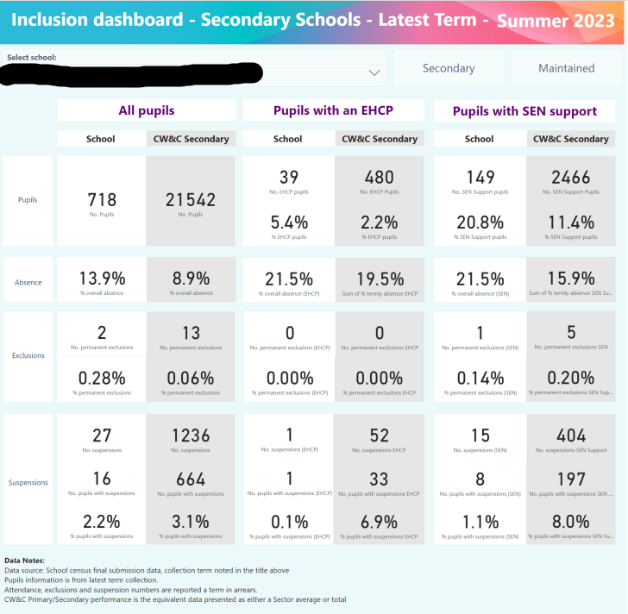
Inclusion Development Work in Progress
Local “Inclusion Dashboard” in development to share high level data with schools about PEX and suspensions data.
FAP processes under consideration with a view to amending the Local Protocol so that some one-off incidents could be referred to FAP rather than being a PEX.
Council Officer representation on a Headteacher led working group around school led Alternative Provision.

Slide 12
Any questions?

